Slide 1




Customer Relationship Management (CRM) in Starbucks using different classification models
For : PGCP DSML
Date : 14th April 2022
© 2021 Jigsaw Academy Education Pvt Ltd.

Slide 2
About the case study and Business Problem Understanding and Description
Not all of customers obtain the offers, and different customers receive different the type of the offers. This can be differed according to the demographic factors or individual purchasing patterns. As an analyst, we should maximize a return-on-investment (ROI), since all marketing campaigns have related-costs. To do so, I identify the desirably-used offers in this analysis. Then I analyze the customers who used the offers desirably, which features do the customers share each other. To be specific, if a customer segment which is likely to react regular offers, so that the offers make the customers regularly purchase drinks at our chains, then our marketing events should focus on the customers, rather than customers who show frequent purchasing patterns regardless of product offers.

Slide 3
Dataset & Data Sources
Data source is from Kaggle. Starbucks is provided three datasets to solve:
  Profile
Rewards program users
Format: json
Size: 17,000 users x 5 features
Included Features:
  gender: (categorical) M, F, O, or null
  age: (numeric) missing value encoded as 118
  id: (string/hash)
  became_member_on: (date) format YYYYMMDD
  income: (numeric)
  Portfolio
Offers sent during 30-day test period
Format: json
Size: 10 offers x 6 features
Included Features:
  reward: (numeric) money awarded for the amount spent
  channels: (list) web, email, mobile, social
  difficulty: (numeric) money required to be spent to receive reward
  duration: (numeric) time for offer to be open, in days
  offer_type: (string) bogo, discount, informational
  id: (string/hash)
  Transcript
Event log, basically transaction records
Format: json
Size: 306,648 events (transactions) x 4 features
Included Features:
  person: (string/hash)
  event: (string) offer received, offer viewed, transaction, offer completed
  value: (dictionary) different values depending on event type
    offer id: (string/hash) not associated with any "transaction"
    amount: (numeric) money spent in "transaction"
    reward: (numeric) money gained from "offer completed"

Slide 4
Approach to the solution & solution description
The problem that I chose to solve is to build a model that predicts whether a customer will respond to an offer. My strategy for solving this problem has four steps. First, I will combine the offer portfolio, customer profile, and transaction data. Each row of this combined dataset will describe an offer's attributes, customer demographic data, and whether the offer was successful. Second, I will assess the accuracy and F1-score of a naive model that assumes all offers were successful. This provides me a baseline for evaluating the performance of models that I construct. Accuracy measures how well a model correctly predicts whether an offer is successful. However, if the percentage of successful or unsuccessful offers is very low, accuracy is not a good measure of model performance. For this situation, evaluating a model's precision and recall provides better insight to its performance. I chose the F1-score metric because it is "a weighted average of the precision and recall metrics". Third, I will compare the performance of logistic regression, random forest, and gradient boosting models. Fourth, I will refine the parameters of the model that has the highest accuracy and F1-score.
Not all of customers obtain the offers, and different customers receive different the type of the offers. This can be differed according to the demographic factors or individual purchasing patterns. As a analyst, we should maximize a return-on-investment (ROI), since all marketing campaigns have related-costs. To do so, I identify the desirably used offers in this analysis. Then I analyses the customers who used the offers desirably, which features do the customers share each other.

Slide 5
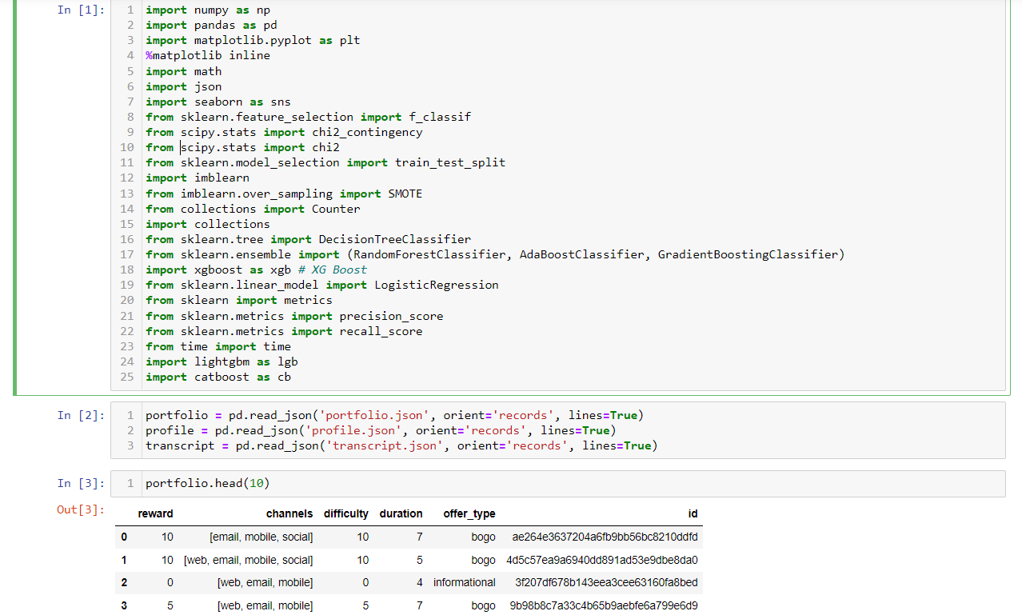
Steps in detail for the solution & code walk-through
Imported necessary loaded the data and checked description, info, null values, duplicated values stored in the data set (refer below image)

Slide 6
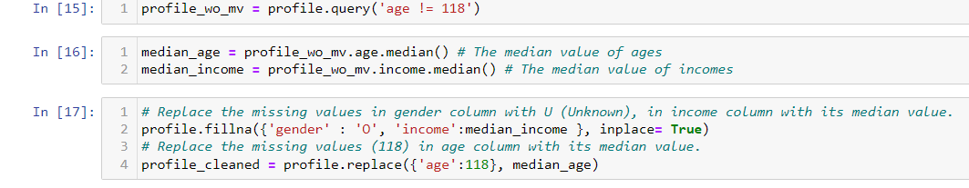
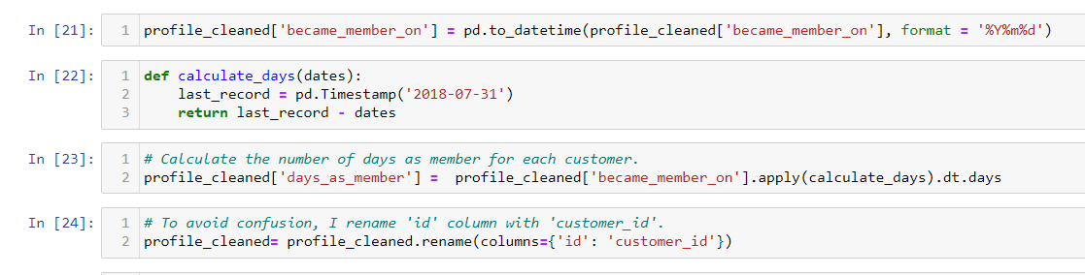
Did the necessary data cleaning parts to the dataset and Imputed the null values (refer below images)

Slide 7
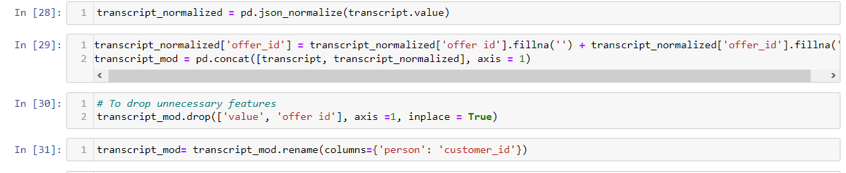
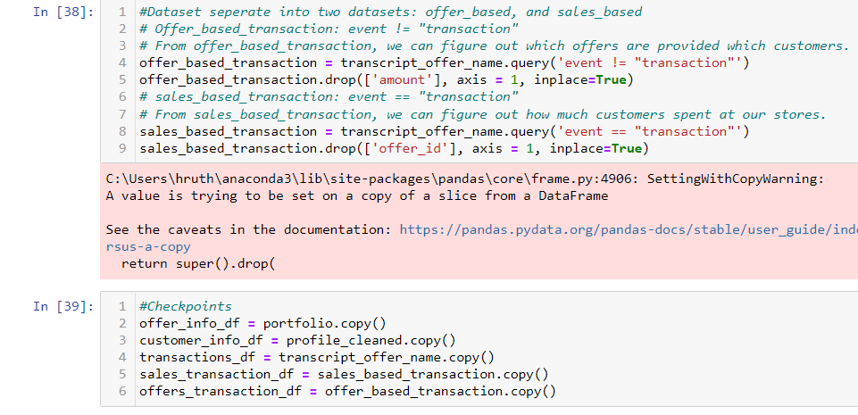
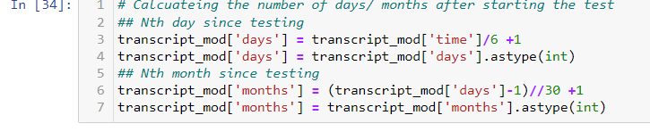

Slide 8
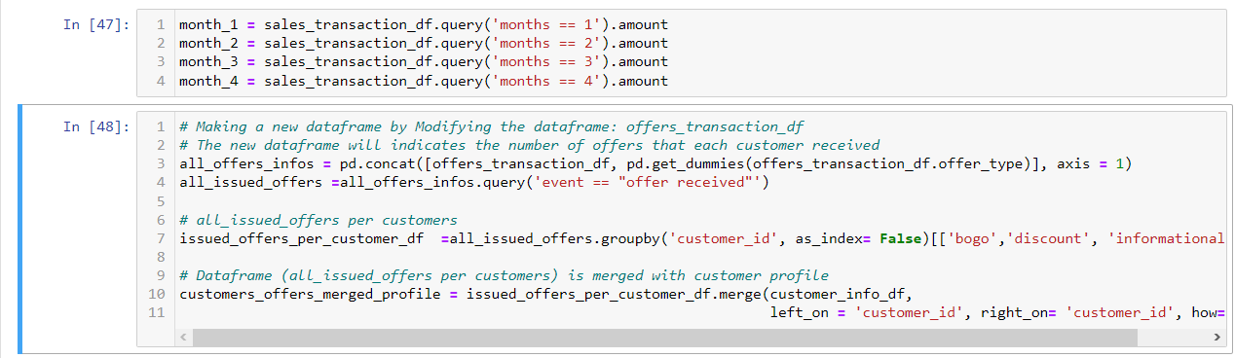
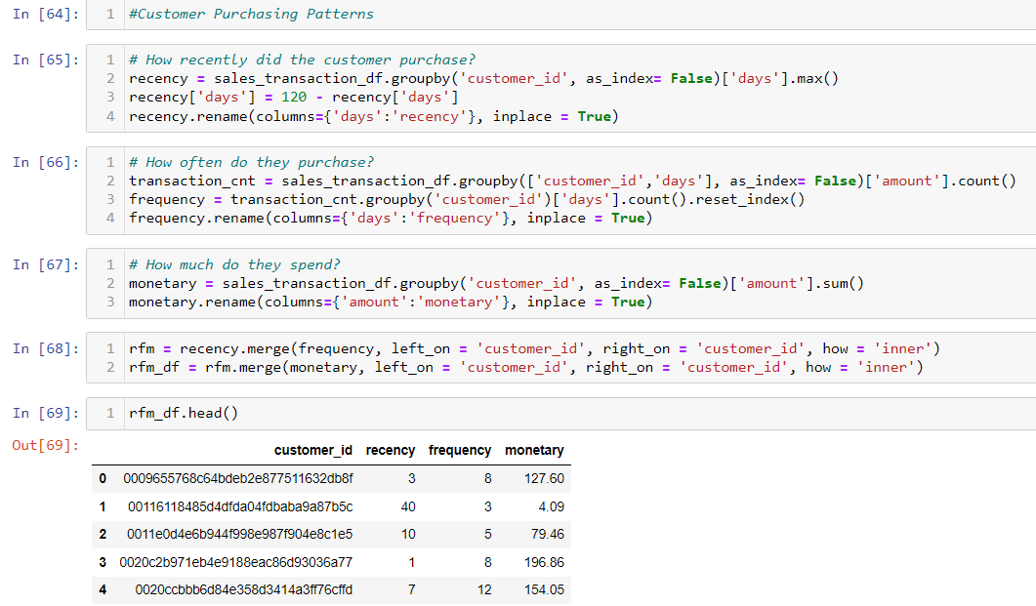
New data frame merged with customer profile
Customer Purchasing Patterns

Slide 9
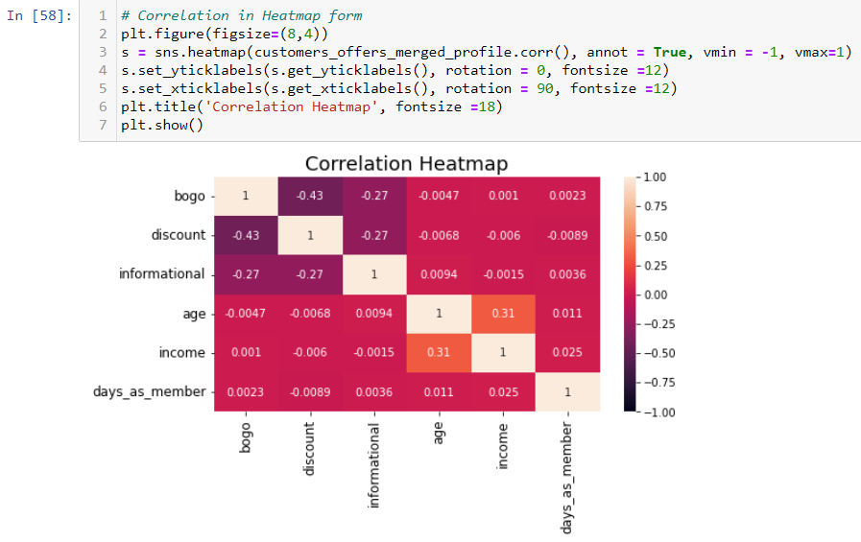
The total number of offers and the number of each type of offers are not correlated with customer's ages, incomes, the number of days as a Starbucks member

Slide 10
Customers Purchasing Patterns using RFM analyses

Slide 11
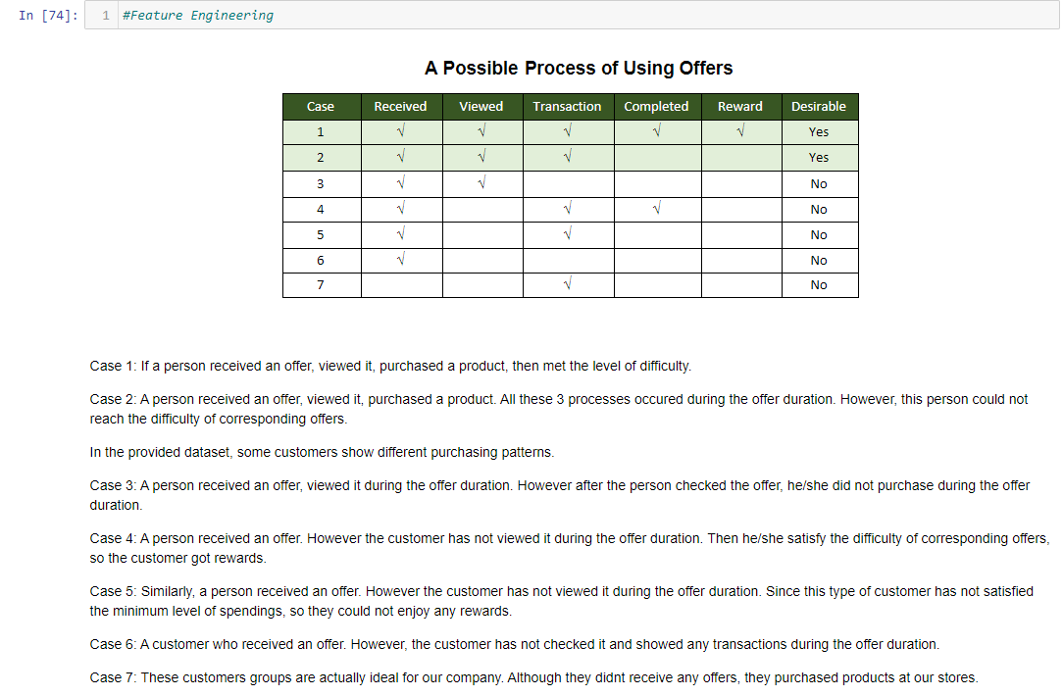

Slide 12
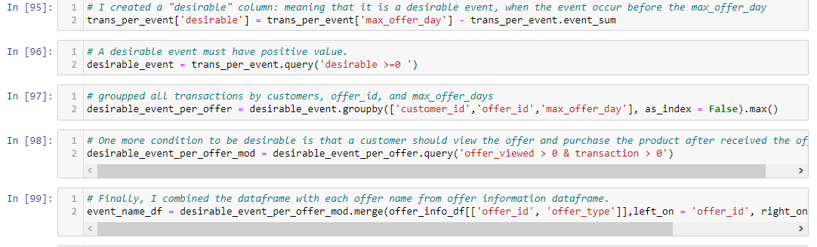
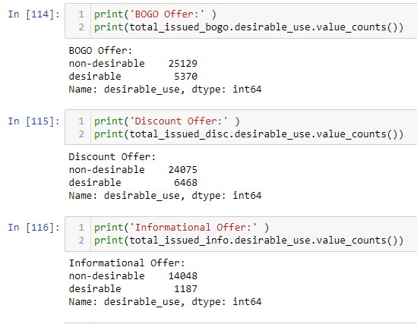
Created new data frame and combined with each offer name and information
Printed the desirable and non desirable count for each type of offer

Slide 13
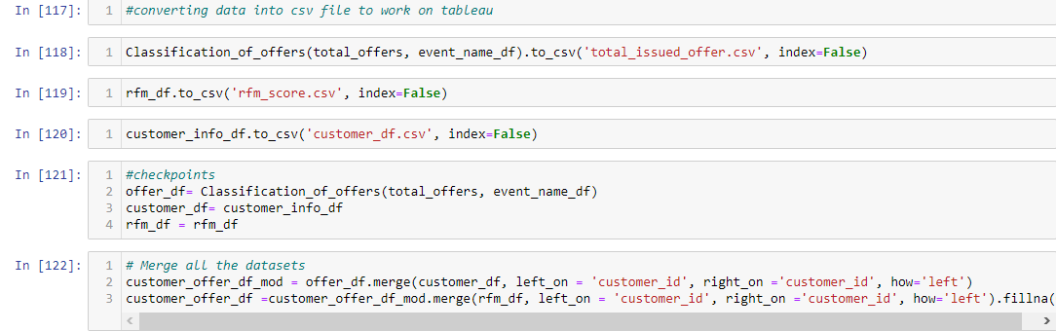
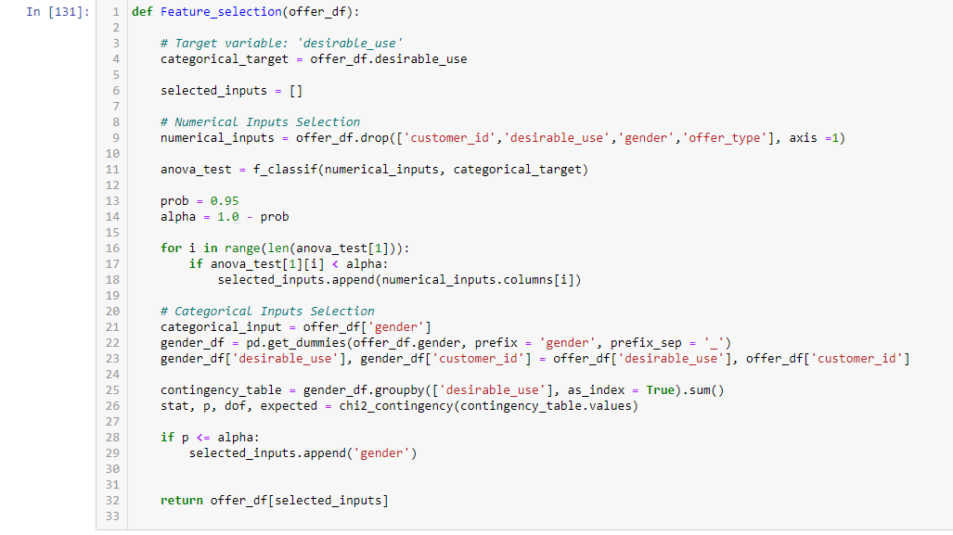
Converting the data frame into csv foam and merged all three data frames into one data frame
Feature selection for the new data frame

Slide 14
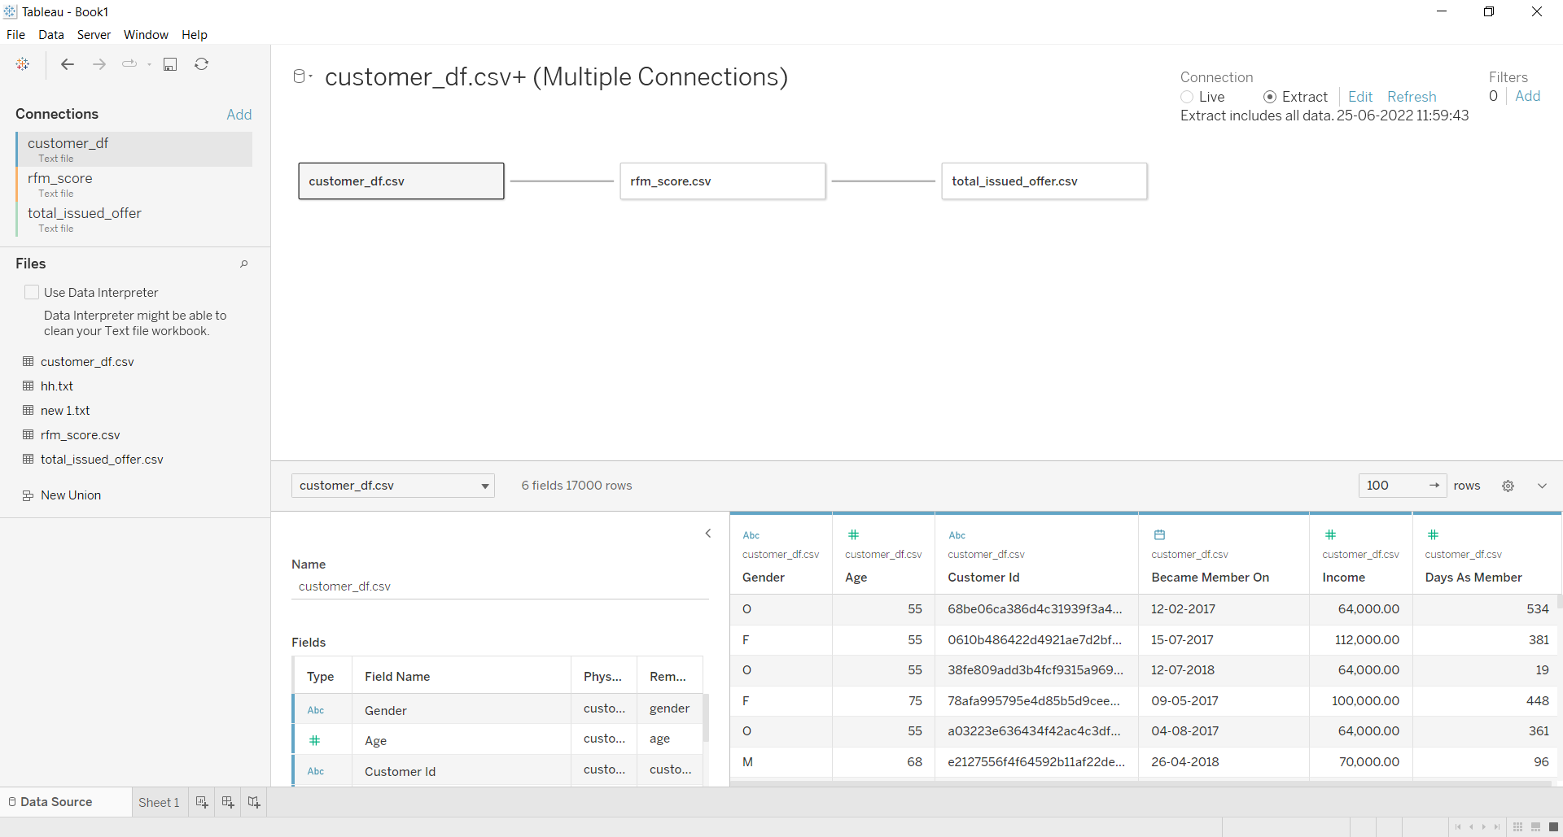
Merged three csv file in the tableau

Slide 15
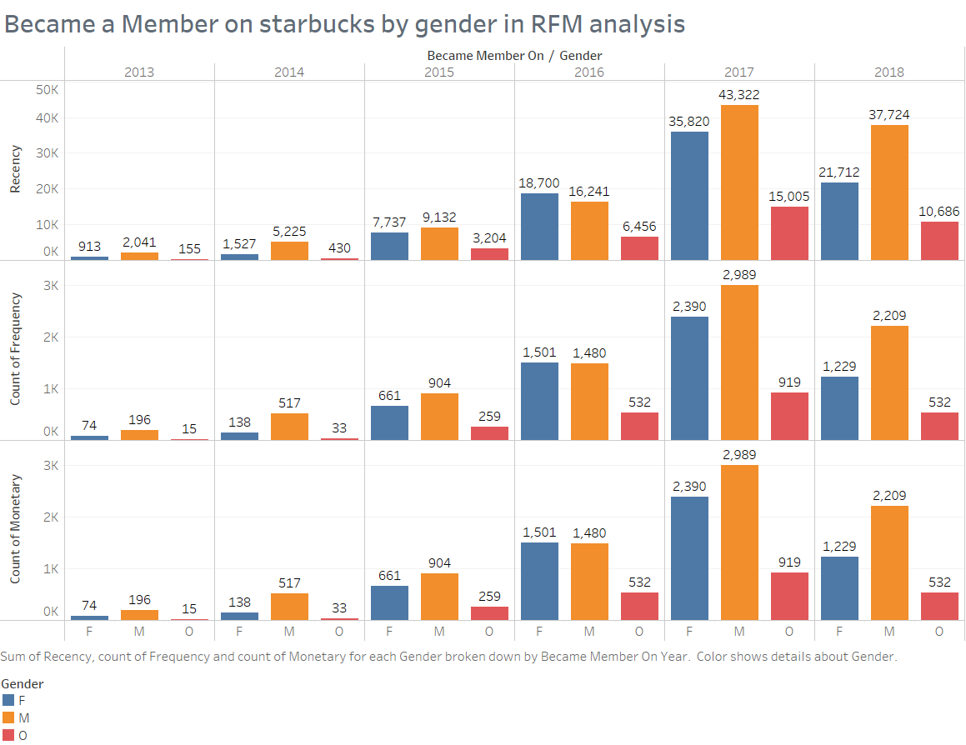

Slide 16
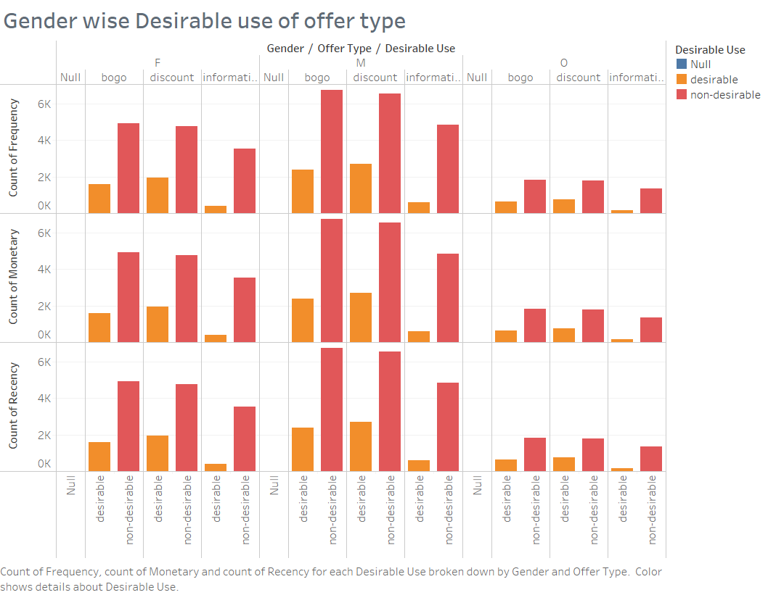

Slide 17
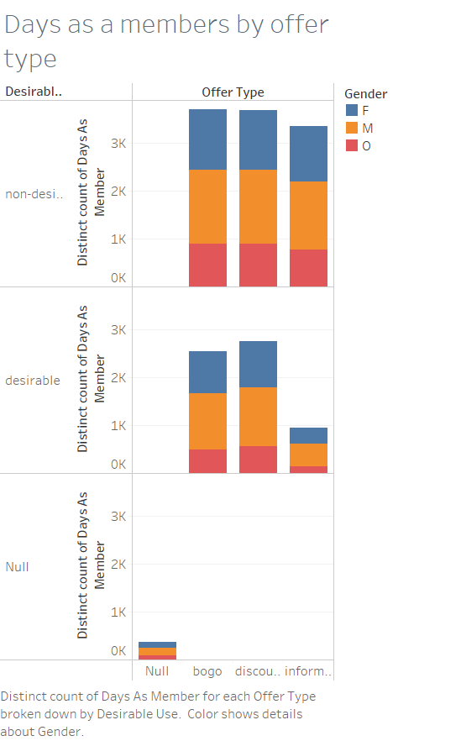

Slide 18
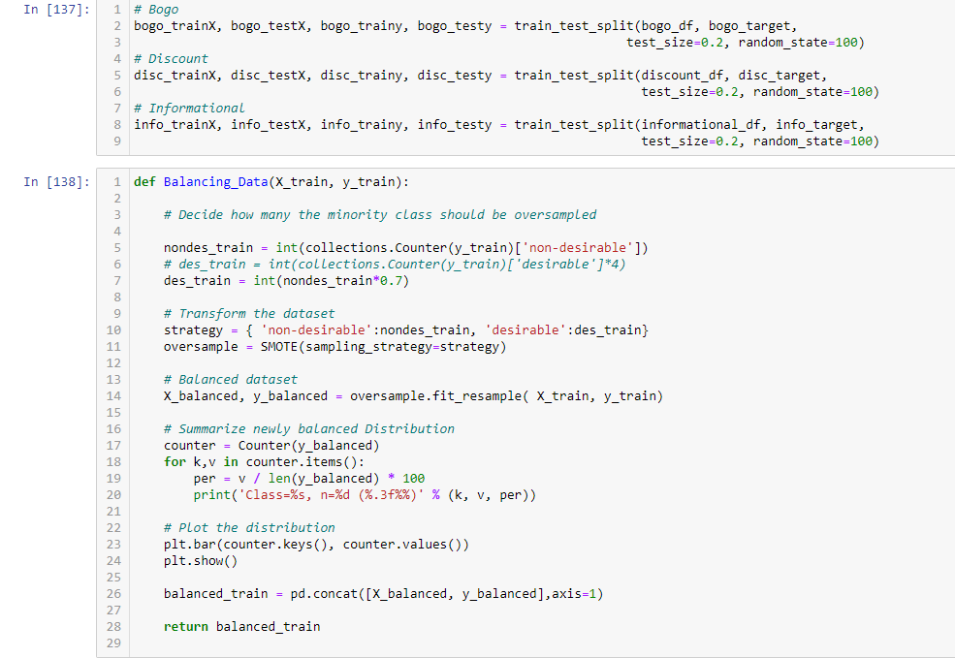
Train and Test split for the model
Balancing the imbalanced data

Slide 19
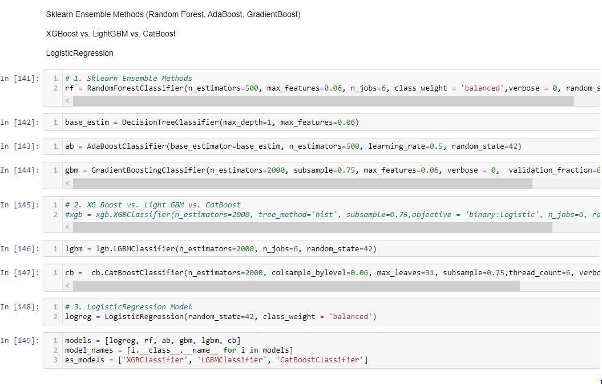

Slide 20
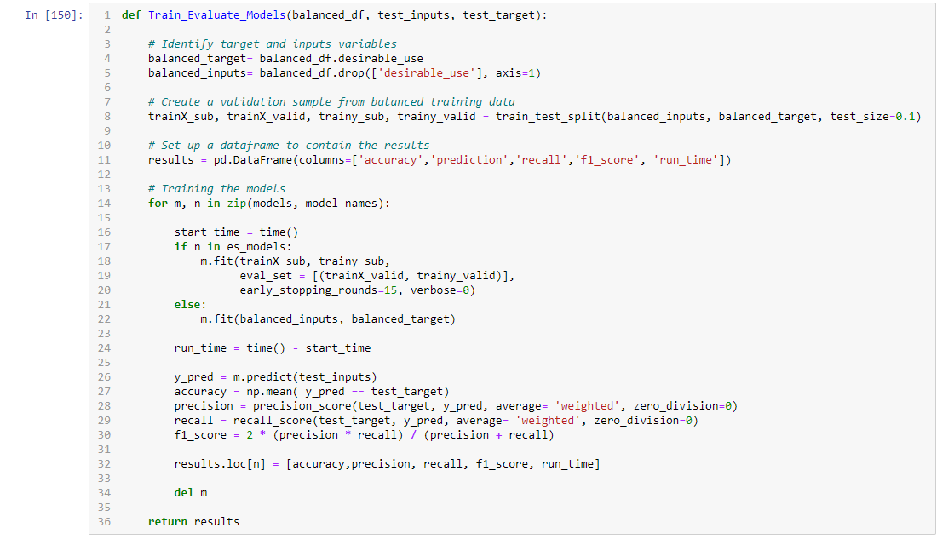
Evaluating the model by defining the model

Slide 21
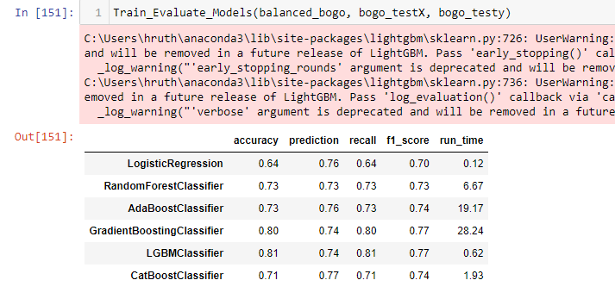
Performance results for BOGO offer

Slide 22
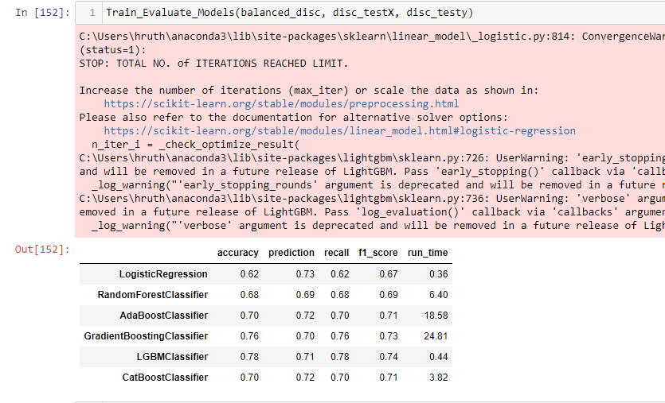
Performance results for DISCOUNT offer

Slide 23
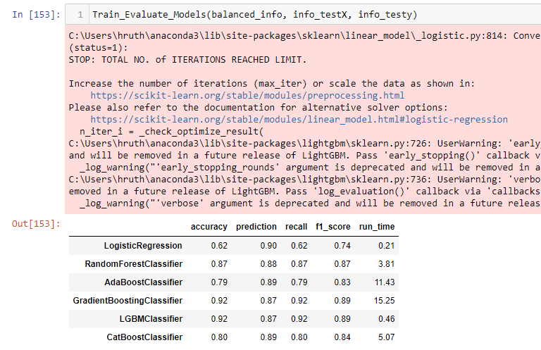
Performance results for INFORMATIONAL offer

Slide 24
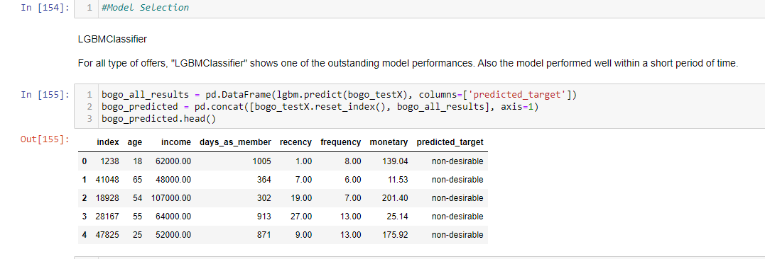
For all type of offers, “LGBMClassifier" shows the outstanding model performance in terms of f1-score. Note that Gradient Boosting Classifier showed the second-best performance. However, the LGBMClassifier shows slightly better performance within much shorter period

Slide 25
Conclusions and insights
In this analysis, I mainly analyzed how customer profiles and their purchasing patterns affect whether the customer use their received offers desirably. To begin with, by exploring current business situations, I found out that providing offers to customers brings increases on total sales amounts. Note that the average spending per each purchase is remarkably similar across the months.
I explored customer purchasing patterns based on RFM analysis. RFM is an evaluation method to analyze customer value. It is often used in database marketing especially in retail and professional services industries. RFM indicates the following 3 dimensions: Recency, Frequency, Monetary Value.
I defined the desirably used offers by both Case 1 and Case 2. Based on the definition, I identified all offer usages into 2 groups: 'desirable', 'non-desirable' per each offer type. As you can see the first bar charts, all three datasets highly imbalanced. Therefore, I alleviated the unbalanced datasets by applying Synthetic Minority Oversampling Technique (SMOTE). Then I trained each dataset with various classification models.
For all type of offers, "LGBMClassifier" showed the optimal model performances. It achieved 0.77, 0.74, 0.89 of f1-score for Bogo, discount, informational datasets, respectively, within the shorter period of time. The f1-score is considerably larger than that of the logistic model. Also, the time duration is much shorter than that of the logistic model. The model with LGBMClassifier is more efficient than the logistic model.

Slide 26



Thank You!
© 2021 Jigsaw Academy Education Pvt Ltd.
© 2021 Jigsaw Academy Education Pvt Ltd.

